Slide 1

Binsted CE Primary Relationships and Sex Education (RSE)
At Binsted we believe in the Christian values of Faith, Hope & Love.

Slide 2
New Guidance and Statutory responsibilites
It is 20 years since the last review of the Personal, Social, Health and Economic (PSHE) education & during that time the World has changed including how we interact with each other.
New- statutory Relationships Education in Primary Schools and previous recommendations for teaching Personal, Social, Health Education, are now part of the National Curriculum.
Sex Education in Primary Schools remains optional, though in Year 5 & 6 the science curriculum form part of what might be considered as sex education- puberty and reproduction.
As a church of England controlled school we also follow CoE guidance – Valuing all of God’s Children.

Slide 3
Valuing All God’s Children Guidance for Church of England schools on challenging homophobic, biphobic and transphobic bullying 2019 - If any school is not educating pupils to understand the rights of all people to live freely within their sexual orientation or gender identity without discrimination they would be failing in their duty to prepare their pupils to live in modern Britain.
The Church of England is committed to an education that enables people to live life in all its fullness and fulfils the words of Jesus in John 10:10:“I came that they might have life, and have it abundantly.”
Central to Christian theology is the truth that every single one of us is made in the image of God. Every one of us is loved unconditionally by God. We must avoid, at all costs, diminishing the dignity of any individual to a stereotype or a problem. Church of England schools offer a community where everyone is a person known and loved by God, supported to know their intrinsic value. This guidance helps schools to offer the Christian message of love, joy and the celebration of our humanity without exception or exclusion
The Most Revd and Rt Hon Justin Welby Archbishop of Canterbury

Slide 4
Church of England schools must ensure that their pupils are secure and able to make excellent progress whatever their background. They are invited into a school that aims to provide an education which leads to an abundant life. Every person in the school community is a child of God. At the heart of Christian distinctiveness in schools is an upholding of the worth of each person: all are Imago Dei – made in the image of God – and are loved unconditionally by God. The hallmark of authentic, life-giving relationships is recognition of the sacredness of the other so that all are welcomed wholeheartedly and with reverence. Each person in all their unique difference should be able to thrive, irrespective of physical appearance, gender, race, religion, ethnicity, socioeconomic background, academic ability, disability, sexual orientation or gender identity.
Church of England schools seek the flourishing of all children and aim to offer a life enhancing encounter with the person of Jesus Christ and the Christian faith. The Church of England’s teaching about marriage has not changed. Whilst same-sex marriage has been legal in England since 2014,same-sex weddings cannot be performed by Church of England clergy or in Church of England churches. There is a breadth of views held about same sex marriage, sexual orientation and gender identity by Christians and people of all beliefs.

Slide 5
Why is Relationships and Sex Education important?
    Entitlement for all children
    Puberty is starting earlier- for some children by age 9
    addresses misconceptions
    Challenging gender bias and stereotyping of relationships
    Teaching children respect and tolerance for themselves & others
    Teaching children about loving, consensual, healthy and affirming friendships & relationships
    Promotes good mental Health and well-being
    Positive body image – recognising that we are all unique & different
    Safeguarding – grooming, sexting & online pornography etc.

Slide 6

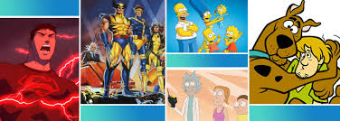

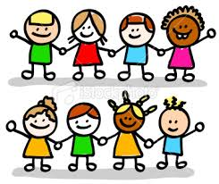
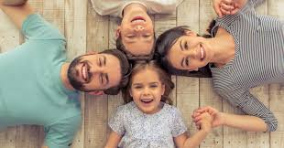
Where and how did you learn about sex and relationships?
For young people, their learning comes from…
Internet
TV
School
Friends & Older Siblings
Parents & Carers

Slide 7
What we are currently teaching in school
Science YR-Y6 to teach the following:
Heartsmart PSHE Y1-Y6 to teach the following:
Pupils should be taught to find out about and describe the basic needs of animals, including humans, for survival. Y1&2
Pupils should be taught to identify, name, draw and label the basic parts of the human body and say which part of the body is associated with each sense. Y1
Pupils should be taught to notice that animals, including humans, have offspring that grow into adults. Y2
Recognise that environments can change and that this can sometimes pose dangers to living things. Y4
Describe the process of reproduction in some plants and animals. Y4
Describe the changes as humans develop to old age.Y4
use a range of key vocabulary when discussing differences in sex, gender identity and sexual orientation. Y6
use scientific vocabulary to accurately explain how babies are made and how they are born Y6
describe the process from conception to birth and the needs of the foetus. Y6
Internet safety & harm Y3-6
Respectful & caring relationships YR-6
Changing adolescent bodies Y4-6
Physical health & fitness YR-3
Healthy eating – Y2&3
Mental wellbeing YR-6
Drugs, alcohol & tobacco Y4-6

Slide 8
Recommendations for Binsted:
Introduce children to the correct scientific terms to describe body parts in Key Stage 1
Have a range of age appropriate books which reflect the rich diversity of family life for example same sex parents.
Continue to challenge the use of language as an insult, e.g.. ‘gay’
Include discussions around the makeup of different families
Explore/ challenge gender roles/ stereotypes
Begin to explore puberty changes by the age of 8/9
Deliver RSE in a progressive, age appropriate way across the school
Ensure that children in Year 4, 5and 6 receive RSE input around puberty so that they are prepared as soon as possible for the onset of puberty
For some sessions on Sex Education consider single gender sessions

Slide 9
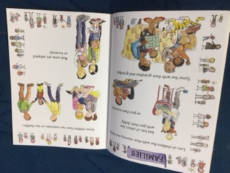
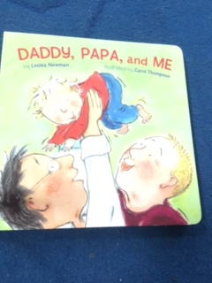
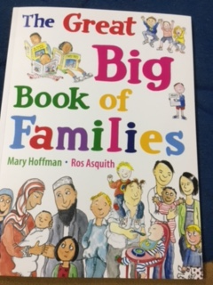
Oak Class books

Slide 10
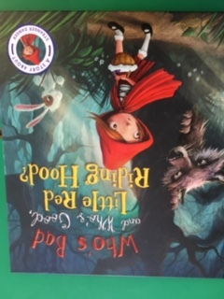
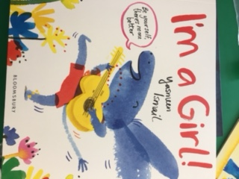
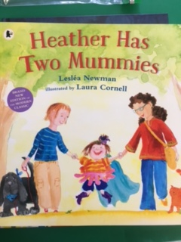
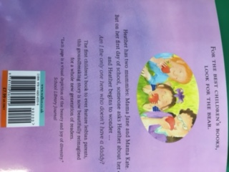
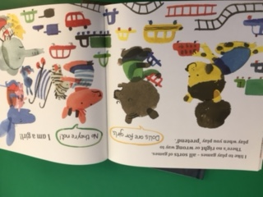
Rowan class – Miss Darby

Slide 11
 | Year R and 1 | Year 2 and 3
Autumn | Children to teach about the roles different people (e.g. acquaintances, friends and relatives) play in our lives. Children to learn about how people make friends and what makes a good friendship. Year 1 Statutory Science Link: Animals and Humans Unit Pupils should be taught to identify, name, draw and label the basic parts of the human body and say which part of the body is associated with each sense. Non – Statutory Guidance: Pupils should have plenty of opportunities to learn the names of the main body parts (including head, neck, arms, elbows, legs, knees, face, ears, eyes, hair, mouth, teeth) through games, actions, songs and rhymes. | Children to learn simple strategies to resolve arguments between friends positively. Children to know how to ask for help if a friendship is making them feel unhappy. Year 2 Statutory Science Link: Animals and Humans Unit Pupils should be taught to find out about and describe the basic needs of animals, including humans, for survival (water, food and air).

Slide 12
Spring | Children taught to identify the people who love and care for them and what these people do to help them feel cared for. Also to know and respect different family types. Children taught how to recognise when they or someone else feels lonely and what to do. | Children learn about different types of families, including those that may be different to their own. ( Including same sex partnerships) Children taught to identify common features of family life. Year 2 Statutory Science Link: Animals and Humans Unit Pupils should be taught to notice that animals, including humans, have offspring that grow into adults. Non-Statutory Guidance: Children should also be introduced to the processes of reproduction and growth in animals. The focus at this stage should be on questions that help pupils to recognise growth; they should not be expected to understand how reproduction occurs
Summer | Children understand that it is important to tell someone (such as their teacher) if something about their family makes them unhappy or worried. | Children understand that it is important to tell someone (such as their teacher) if something about their family makes them unhappy or worried. Year 2 Statutory Science Link: Animals and Humans Unit Pupils should be taught to describe the importance of exercise for humans, eating the right amounts of different types of food and hygiene.

Slide 13
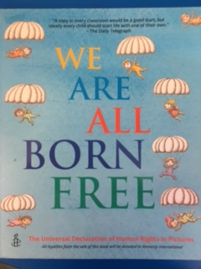
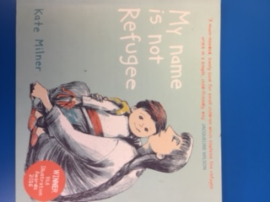
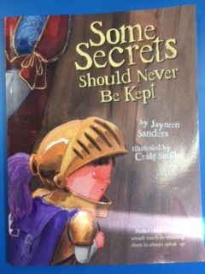
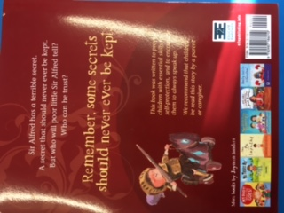
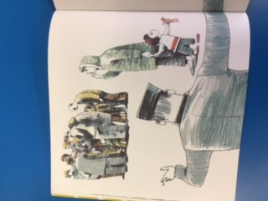
Beech Class –
Mr Jennings

Slide 14
Y4 RSE Assessment Statements
It’s my body- Non-statutory
list some of the effects of sleep deprivation.
explain the effect of exercise on the heart.
know how to get help for themselves or another in the case of serious problems.
explain why eating a balanced diet is important.
know how to check medicine instructions.
know how to inhibit the spread of germs.
explain the importance of vaccinations and immunisations.
Growing up Non-statutory
• explain what the male and female reproductive body parts are for;
• discuss ways in which people can deal with or overcome emotions experienced during puberty;
• show respect for the differences between different families;
• describe the different types of relationship that exist, without prejudice;
• show an awareness of myths surrounding pregnancy and birth;
• describe the conception and birth of a baby, using some scientific vocabulary.
Science Statements – National Curriculum Year 4- Statutory
recognise that living things can be grouped in a variety of ways
explore and use classification keys to help group, identify and name a variety of living things in their local and wider environment
recognise that environments can change and that this can sometimes pose dangers to living things.
describe the simple functions of the basic parts of the digestive system in humans
identify the different types of teeth in humans and their simple functions
construct and interpret a variety of food chains, identifying producers, predators and prey.

Slide 15
Y5 RSE Statements Non-Statutory
Assessment Statements – It’s My Body
• explain the importance of vaccinations and immunisations;
• identify the implications of not getting enough sleep;
• understand why they need to change some of their habits and routines as they get older;
• identify where the pressure to try harmful substances might come from;
• understand that many images seen in the media are artificially enhanced;
• understand that the choices they make about their bodies have consequences.
Assessment Statements – Growing up Non-Statutory
• explain how to look after their bodies during puberty.
• name some ways to cope with new or difficult emotions.
• describe some of the ways in which the media fuels the notion of a perfect body.
• describe the different types of loving relationships that exist.
• explain the laws around sexual relationships.
• use a range of key vocabulary when discussing differences in sex, gender identity and sexual orientation.
• use scientific vocabulary to accurately explain how babies are made and how they are born.
• describe the process from conception to birth and the needs of the foetus.
Y5 Science National Curriculum Statutory
Describe the differences in the life cycles of a mammal, an amphibian, an insect and a bird.
Describe the process of reproduction in some plants and animals.
Describe the changes as humans develop to old age.

Slide 16
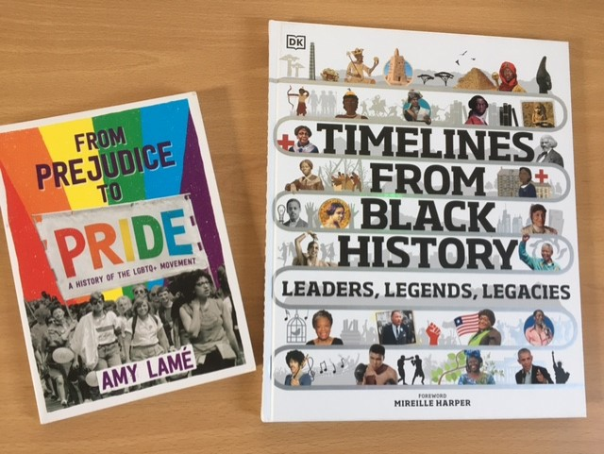
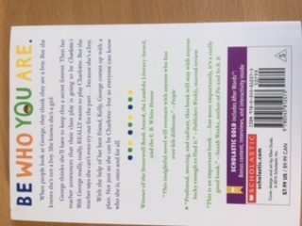
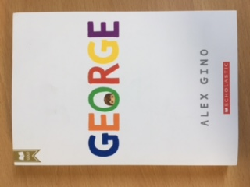
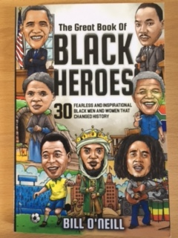
Silver Birch Class

Slide 17
RSE 2021 Y6 Curriculum – these areas overlap with Science, PE, PSHE and Computing
Autumn
Make informed decisions about my health
Explain what constitutes a healthy diet
How medicines contribute to a healthy lifestyle (inc. immunisation and vac.)
About benefits of sun exposure and risks
About benefits of the internet and risks
Who to go to if you are worried about health
Define consent and autonomy
Spring
That mental health is an important part of daily life and importance of mental health
Strategies and behaviours of mental health
Feelings can change in time and intensity
To recognise the warning signs about mental health
To recognise how personal identity contributes to who we are
To recognise that for some people gender identity does not correspond to their biological sex

Slide 18
Year 6 Summer – Sex ED
RSE
To identify external genitalia and internal repro organs using correct terminology
Recap physical and mental changes that happen when approaching puberty
Recap hygiene routines
Name some ways to cope with new or difficult emotions.
Describe some of the ways in which the media fuels the notion of a perfect body.
Science Curriculum
• explain how to look after their bodies during puberty. (NS)
• describe the different types of loving relationships that exist.(NS)
• explain the importance of safety and love around sexual relationships. (NS)
• explain what contraception is, how it is used and what it is used for.(NS)
• use a range of key vocabulary when discussing differences in sex, gender identity and sexual orientation. (S& NS)
• use scientific vocabulary to accurately explain how babies are made and how they are born
• describe the process from conception to birth and the needs of the foetus.

Slide 19
Summary
Parents have the right to withdraw children from Sex Education lessons at Primary School that go beyond the content in the Science National Curriculum.
Topics covered related and linked to the Science Curriculum are statutory and not optional to teach. School’s have the right and obligation to teach RSE topics to prepare children for life when they leave school.
The RSE curriculum will help to educate and equip our children for today and tomorrow.
The RSE will be supported by the school’s wider policies on Behaviour, bullying and safeguarding.

Slide 20
Book List as recommended by Hampshire library services
Silver Birch
George by Alex Gino
From Prejudice to Pride by Amy Lame
The great book of black heroes by Bill O’Neill
Timelines from Black History Leaders, Legends, Legacies by Mireille Harper
Beech
A storm of Strawberries The world can change in a day by Jo Cotterill
Black History Kids edition Great Kings and Queens of Africa by Stephen Jones SR
The secrets of Sam and Sam by Susie Day
Spectre Collectors Too Ghoul for School by Barry Hutchinson
Some Secrets should never be kept by Jayneen Sanders

Slide 21
Rowan
I’m a Girl by Yasmeen Ismail
Heather has two Mummies by Leslea Newman
Who’s Bad and who’s good, Little Red Riding Hood
The Great Big Book of Families by Mary Hoffman & Ros Asquith
Oak
Stella brings the Family by Miriam B Schiffer
It’s okay to be different by Todd Parr
The Great Big Book of Families by Mary Hoffman & Ros Asquith
Daddy, Papa, and Me by Leslea Newman

Slide 22
As part of this process, the school is consulting with parents, staff and governors to help to inform our schools’ decisions on when and how certain content is covered.
The Consultation Questions are as follows:
1. Would you like support at home, on how to speak to your child about relationships and sex?
2. Are there any changes or additions that you think should be made to the RSE Policy?
3. Are there any changes or additions that you think should be made to the RSE Curriculum Outline?
4. Thinking about relationships and sex education, what do you believe is the most important subject area that should be taught for different age groups/key stages and why?
5. Thinking about relationships and sex education, is there an area that you think should not be taught for different age groups/key stages and why?
Please feel free to email any comments by 21/05/21 to s.morton@binsted.hants.sch.uk.

Slide 23
Questions? Comments?

