Slide 1


EYFS, KS1 and KS2
Reading at Home
Keeping it Fun!!

Slide 2
What are our aims?
To give an overview and understanding of how to make reading fun at home

Slide 3
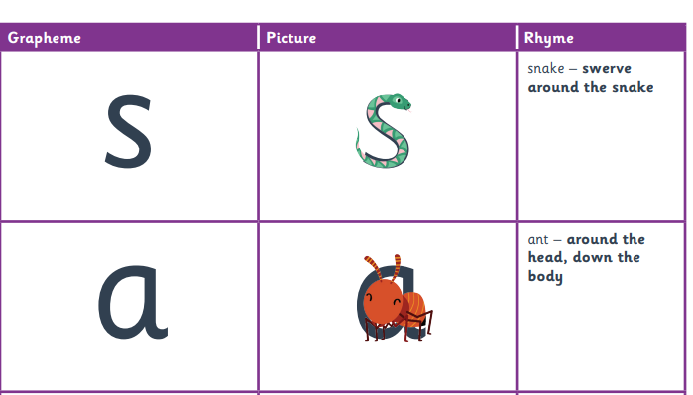
Why this Reading Book?
Sounds should be matched to what the children have been taught in class
We teach Reading through phonics
Try and build it in to your daily routine
Picking the right time of day
Reading to a range of adults etc
Reading in different places is good

Slide 4
How to set it up?
Try and build it in to your daily routine
Picking the right time of day
Reading to a range of adults etc
Reading in different places is good

Slide 5

Front Cover
Title
What could the book be about?
What does it make you think of?
Have you read any other similar books?

Slide 6
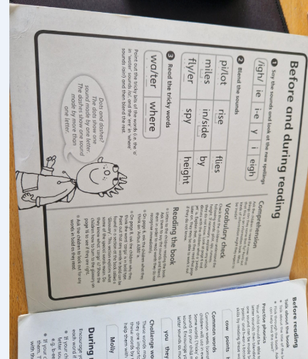
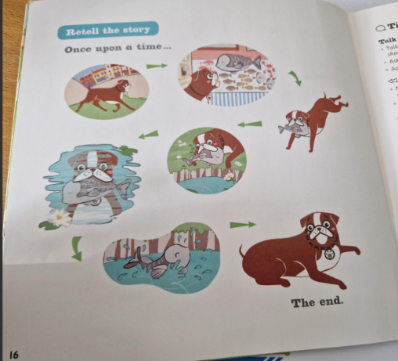
Review the Phonics words and sounds
Start of the book will have a review of the sounds
Even if you are starting in the middle still review these

Slide 7
Reading the Story-discuss pictures as you go
-Get them to read it to you
-Point at the words
-Encourage them
-Ask them to sound it (what do you know?)
-Read the word if they are unable to

Slide 8
Ideas to support all children-making it fun…
Discuss the book first – what might it be about?
· Look at the pictures on the cover.
• Bring stories to life with lots of expression and
silly voices.
• Talk about the stories and pictures and play ...
‘Guess what’s going to happen next’.
·• Let your child ‘read’ the book to you by talking
about the pictures.
• Read favourite books over and over again

Slide 9
Say the catchy bits together, e.g. ‘he huffed
and he puffed and he blew the house down’.
• Learn rhymes, songs and jingles together so you both know them by heart and can point to
the words as you recite them together.
• Learning the sounds of the letters of the alphabet will help your child to read.
• Look at different styles of print to help your child to recognise letters even when they’re not exactly the same.
• Collect things beginning with a given letter.

Slide 10
What happens if it goes wrong?
Keep it positive
Avoid saying “we have to do this…”
Use strategies such as: You read a page I read a page, I read you follow, pick out key words
Let’s make up our own story using our own words

Slide 11
What’s New? Ebooks from Essential Letters and Sounds

Slide 12
What does this mean for reading?
Working on sounds and reading stories.
KEEP READING TO THEM…

Slide 13
By the end of Year One children should…
Respond speedily with the correct sounds to
graphemes.
Read accurately by blending sounds.
Read common exception words.
Develop pleasure in reading and motivation to read.
Understand both the books they can read independently and those they listen to.

Slide 14
By the end of Year Two children should…
Read accurately by blending sounds and recognising alternate sounds for graphemes.
Read accurately words of two or more syllables.
Read aloud books closely matched to their improving phonic knowledge, sounding out unfamiliar words without hesitation.
Read frequently encountered words quickly, accurately and without overt sounding and blending.
Re-read books to build up fluency and confidence.
Develop pleasure in reading and motivation to read through becoming increasingly familiar with a wider range of texts.
Participate in discussions about texts.

Slide 15
How do we promote and develop reading at KS1?
Read to and discuss lots of different texts with the children.
Continue teaching phonics in Year One,
(and in Year Two if they do not pass the
phonics test at the end of Y1).
Ebooks at home which link to the phonics sounds your child is being taught.
Provide additional ‘home reading books’ that the
children can read with
greater independence and
develop their fluency.

Slide 16
Supporting at Home
Read a range of texts to your child and discuss what you have read.
Make reading time together a ‘positive, quality time’.
Try to do reading in small ‘chunks’. Little and often works best, particularly in the early stages!
Finish reading and re-read the guided reading book with your child.
Come and speak to me or your child’s teacher if he/she is reluctant to read at home.

Slide 17
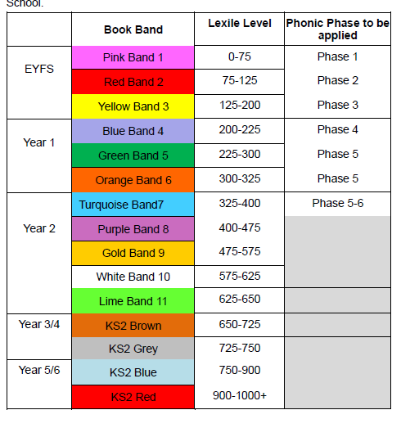
Book Bands

Slide 18
Free Readers
What does it mean?
It requires a good level of maturity to ensure the variation is there
Should open up a whole world of reading!
BUT, if your not convinced speak to your child’s teacher!

Slide 19
Making It Fun/Relevant
THINGS THAT YOU CAN DO WITH YOUR CHILD TO
HELP THEM TO BECOME FLUENT READERS
The following hints and ideas will help you to assist your
child on the road to becoming an independent, fluent
reader.
However, remember, the most important thing that
you can do to help your child, whatever age or
stage that they are at is to simply enjoy sharing and
reading books to them and with them. Also,
remember that you are their role model, make sure
your child sees you reading newspapers, books and
magazines – show them it’s cool to read!

Slide 20
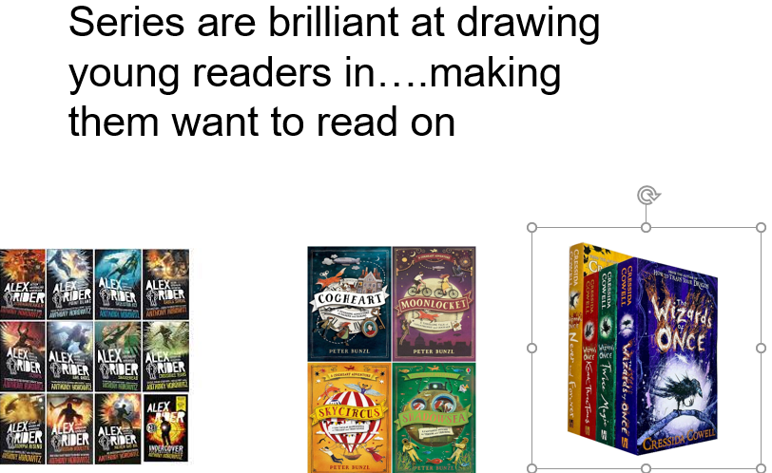
Getting them to continue reading

Slide 21
???????????
If in doubt ask!

