Slide 1



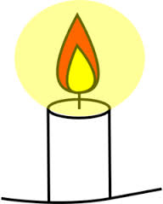
What does Spirituality mean for Binsted Church of England Primary School?
Self – Our understanding of who we are
Others – How our self-understanding shapes our relationships with others
Beauty – Our wonder at life and creativity
Beyond – Our sense of mystery and higher purpose
Connections
Connections
Connections
At Binsted we understand the term ’Spirituality’ as our sense of belonging to, and caring for, something beyond ourselves. This can be expressed through religious faith. It means having the confidence to ask questions which go beyond our immediate experiences and having a sense of who we are and where we fit into the greater picture of our wonderful world and beyond.
We aim to become Spiritual learners through reflecting and exploring our awareness of the four connected areas of ‘Self’, Others’, Beauty and ‘Beyond’.
As a Church school we welcome all faiths or none; we recognise that for Christians their spirituality is grounded in the belief of God and his Son, Jesus Christ.

